Slide 1

Angular Fundamentals
Course Overview, Trainers, Evaluation
SoftUni Team
Technical Trainers
Software University
https://softuni.bg/

Slide 2

Table of Contents
Course Overview
Course Objectives
Course Topics
Trainers Team
Exams and Evaluation
Learning Resources

Slide 3
Have a Question?
sli.do
#js-web

Slide 4

Angular Fundamentals
Course Objectives & Program

Slide 5

Course Objectives
The Angular Fundamentals course provides
Basic understanding of TypeScript and Angular
Covers component-based architecture
Working with remote data using RxJS
What is NOT covered?
JavaScript basics and syntax
REST communication fundamentals

Slide 6
Warning: Not for Absolute Beginners
The "Angular" course is NOT for absolute beginners
Requirements
HTML & JS (ES 2016) coding skills – intermediate level
If you want you can take the HTML & CSS Mini Course at SoftUni first:
HTML & CSS
Computer English – entry level

Slide 7

Course Topics
Angular overview, TypeScript, Installation, CLI
Components, data binding, lifecycle
SOLID, RxJS, Observables, Services
NgModule, Routing, Guards, Lazy Loading
Directives, Template-Driven & Reactive Forms

Slide 8
Course Topics (2)
Pipes, JWT, Interceptors, Angular Animations
Code Styling, Architecture, Unit Testing
Redux State Management, NgRX
Workshop Angular Material

Slide 9

The Team

Slide 10
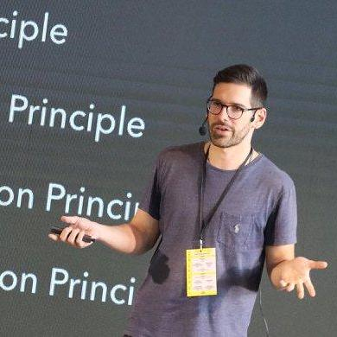
Ilia Idakiev
Software developer-entrepreneur
JavaScript enthusiast
Many years of web application development experience
Co-organizer of Angular Sofia and SofiaJS / BeerJS
Lecturer at Sofia University (FMI)
"Advanced JavaScript" course

Slide 11

Ines Ivanova
Top student @ SoftUni
Front-end developer
Worked at a startup in the area of data science
Python, C#, Angular 5 HTML, CSS, jQuery
In the free time enjoys learning C++

Slide 12
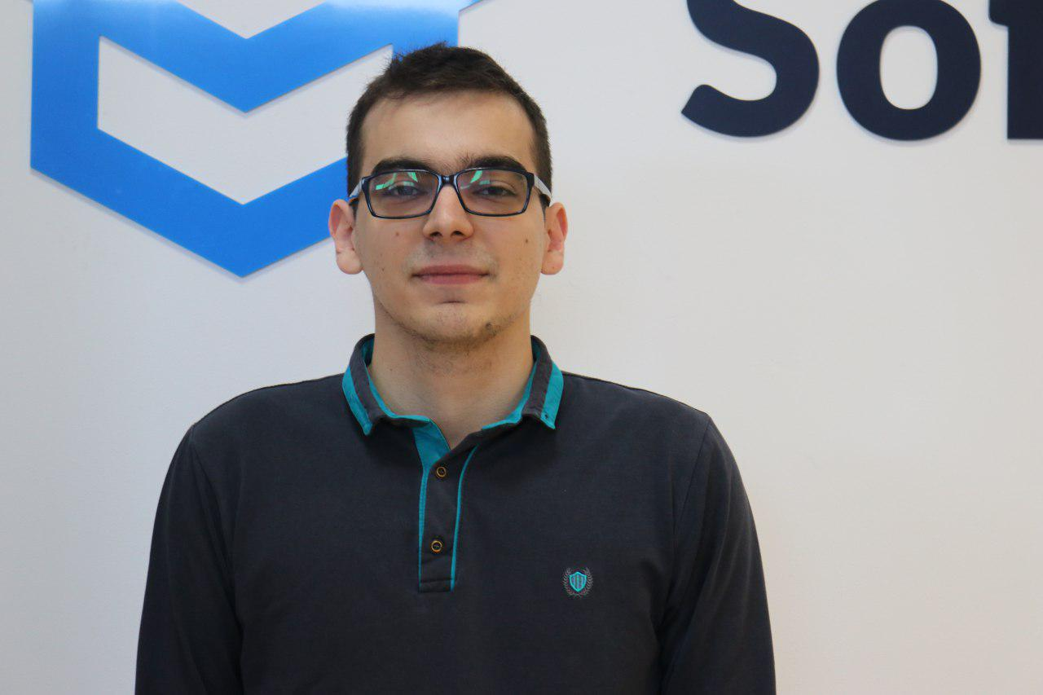
Kiril Kirilov
Team Lead @ SoftUni
Involved with programming since high-school
Passionate about .NET, JavaScript, Angular
Currently studying Math & Informatics at Sofia University (FMI)

Slide 13

Course Organization

Slide 14

Training Duration
Lessons: ~30 hours (onsite + videos)
Practical exercises (in class): ~30 hours
Project Defense: 15 minutes
Defense date: 21 April 2019
Retake defense date: 25 April 2019

Slide 15

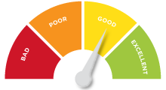
Scoring System for the Course
Project – 90%
Homework (exercises) – 10%
Bonuses: up to 10%
Presence in class: 5% (onsite students only)
Forum activities: 5%

Slide 16



Learn to Search Online
The course assignments require searching online
This is an important part of the learning process
Some exercises intentionally have no hints
Learn to find solutions!
Software development includes everyday searching and learning
No excuses, just learn to study!
Developers learn new technologies, tools, languages every day!

Slide 17

Homework Assignments
Doing your homework is very important!
Programming can only be learned through a lot of practice!
You should write code every day!
Each lesson is followed by many exercises
Try to solve them in class
The rest are your homework
Homework assignments are due 7 days after each lecture
Submission through the course page

Slide 18
https://softuni.bg/courses/angular-2-fundamentals

Slide 19













SoftUni Diamond Partners

Slide 20




SoftUni Organizational Partners

Slide 21




Trainings @ Software University (SoftUni)
Software University – High-Quality Education and Employment Opportunities
softuni.bg
Software University Foundation
http://softuni.foundation/
Software University @ Facebook
facebook.com/SoftwareUniversity
Software University Forums
forum.softuni.bg

Slide 22

License
This course (slides, examples, demos, videos, homework, etc.) is licensed under the "Creative Commons Attribution-NonCommercial-ShareAlike 4.0 International" license

